Slide 1



17th Europe-INBO Conference
Lahti, Finland, 17-20 June 2019

Slide 2
Closing session
Séance de clôture
17th Europe-INBO Conference
Lahti, Finland, 17-20 June 2019

Slide 3
Report on the Workshop on NBS
Rapport sur l’atelier SFN
17th Europe-INBO Conference
Lahti, Finland, 17-20 June 2019

Slide 4
Report of the 4 roundtables
Rapport des 4 tables-rondes
17th Europe-INBO Conference
Lahti, Finland, 17-20 June 2019

Slide 5
Invitation to 2020 Europe-INBO Conference in Malta
Mr Michael Schembri
Deputy Water Director, Malta
17th Europe-INBO Conference
Lahti, Finland, 17-20 June 2019

Slide 6
Présentation de la prochaine Assemblée générale du RIOB 2019
Mr Mhamed El Fasskaoui
Agence de Bassin Hydraulique Souss-Massa, Maroc
17th Europe-INBO Conference
Lahti, Finland, 17-20 June 2019

Slide 7
11th INBO World General Assembly
Marrakech
Sept. 30th – October 3rd, 2019

Slide 9
Déclaration de Lahti Declaration
Daniel Valensuela
INBO Secretariat
17th Europe-INBO Conference
Lahti, Finland, 17-20 June 2019

Slide 10
Mr Eric Tardieu
Secretary General
INBO
17th Europe-INBO Conference
Lahti, Finland, 17-20 June 2019

Slide 11
Many thanks
17th Europe-INBO Conference
Lahti, Finland, 17-20 June 2019

Slide 12
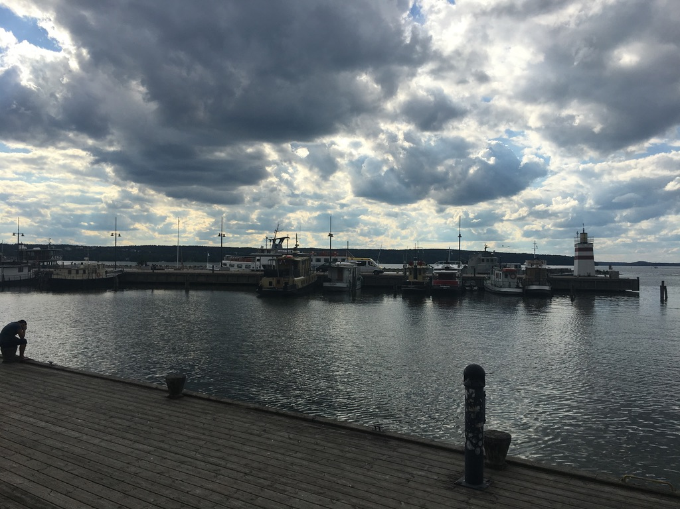
17th Europe-INBO Conference
Lahti, Finland, 17-20 June 2019

Slide 13
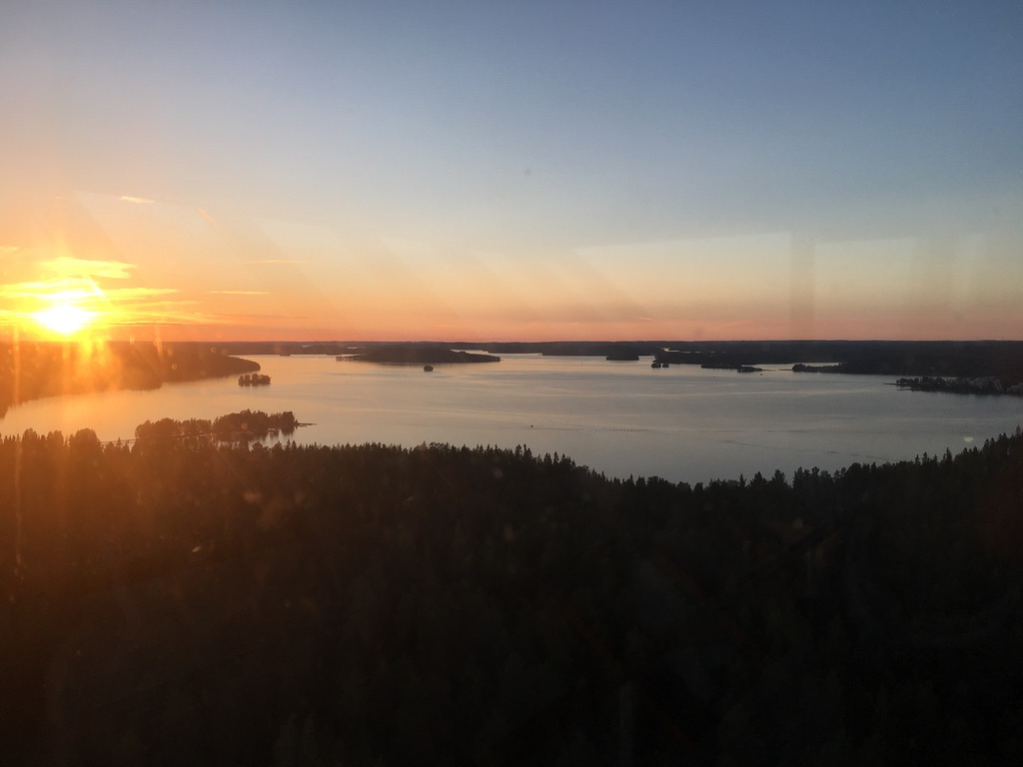
17th Europe-INBO Conference
Lahti, Finland, 17-20 June 2019

Slide 14
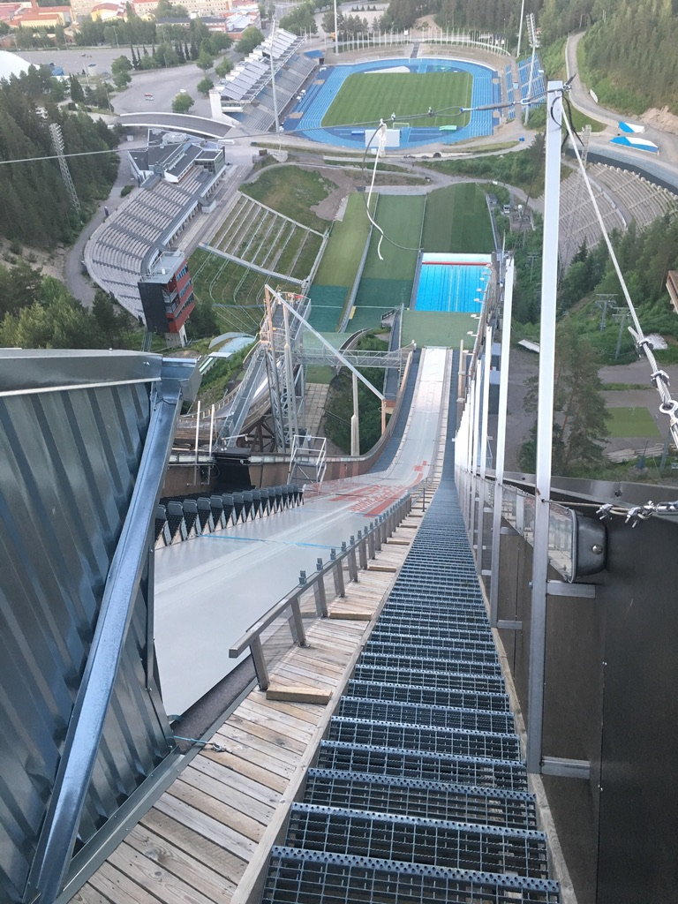
17th Europe-INBO Conference
Lahti, Finland, 17-20 June 2019

Slide 15
…and see you next year in Malta !
17th Europe-INBO Conference
Lahti, Finland, 17-20 June 2019

Slide 16
Concluding speeches
Discours de clôture
Séance de clôture
17th Europe-INBO Conference
Lahti, Finland, 17-20 June 2019

Slide 17
Mr Alejandro Rodríguez González
Europe-INBO Presidency 2018-2019
Hydrographic Confederation Guadalquivir, Spain
17th Europe-INBO Conference
Lahti, Finland, 17-20 June 2019

Slide 18
Mr Timo Jokelainen
Europe-INBO 2019 Presidency
ELY Center of Lappland, Finland
17th Europe-INBO Conference
Lahti, Finland, 17-20 June 2019

Slide 19
17th Europe-INBO Conference
Lahti, Finland, 17-20 June 2019
www.inbo-news.org

